Slide 1
5.
a) Describe how propeller shaft/stern bearing clearance is measured.
b) Identify with reasons the major factors which substantially determine the range of permissible clearance.
c) State with reasons what parts of propeller shafts should receive particularly close inspection upon withdrawal of such shafts for survey.
d) State why some propeller shafts require less frequent inspection than others

Slide 2
a) Describe how propeller shaft/stern bearing clearance is measured
1 Propeller Shaft Clearances - Measurement
Periodical docking surveys and periodical propeller shaft surveys are incomplete without propeller shaft clearances. These may be determined as bellows:
When the shaft is removed for survey or maintenance, by calibration of journals and bearing bores.
When bearing is exposed with shaft in place for partial survey or seal maintenance, by feelergauges, or soft wood wedge driven between shaft and bearing then measured with calipers.
Normal running condition, by poker gauge comparing readings with previous measurements.
In normal running condition, by lifting shaft and measuring the lift by dial gauge (Less accurate). Case needed to avoid undue force.
Assessment of poker gauge readings can only be made if records of the previous readings are available, and the relative shaft clearance is known. Poker gauge readings taken in isolation produce no reliable value of bearing clearance.

Slide 3
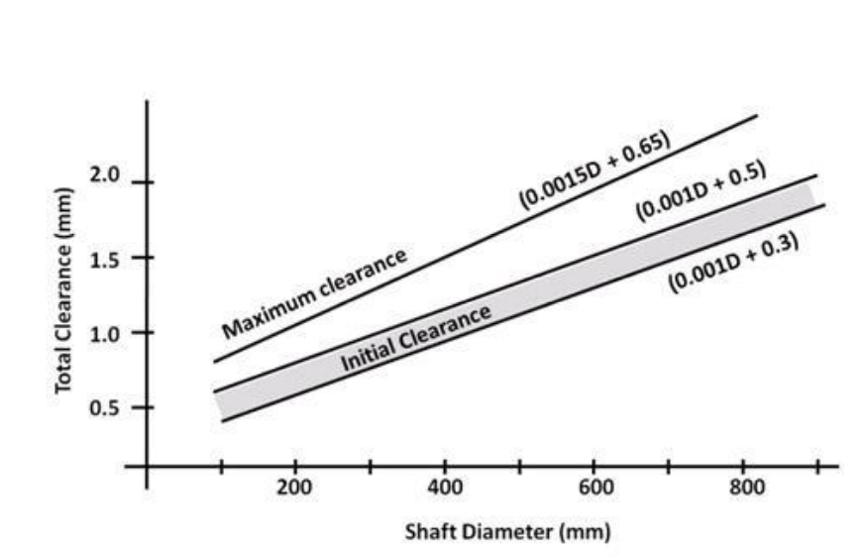
b) Identify with reasons the major factors which substantially determine the range of permissible clearance.
Major factors determining the range of permissible clearance include:
Shaft Diameter: Larger shafts require larger clearances to accommodate thermal expansion and to ensure that the oil film (or water layer) can be properly maintained over a larger surface area without causing excessive friction.
Lubrication Type (Oil vs. Water):Oil-Lubricated Bearings: Use white metal (babbitt) and require tighter tolerances to maintain a pressurized hydrodynamic oil film, as they operate under higher speed and pressure.
Water-Lubricated Bearings: Use Lignum Vitae, rubber, or synthetic materials. They require greater clearance because water has a much lower viscosity than oil, making it necessary to have a thicker film to prevent metal-to-metal contact, along with a need for space for water-borne abrasive particles (sand) to pass through without causing scoring.
Bearing Material: The material's thermal expansion properties and wear resistance dictate the initial clearances. Soft materials like rubber (water-lubricated) swell and require more clearance, while hard, metallic materials in oil-lubricated systems allow for closer tolerances.

Slide 4
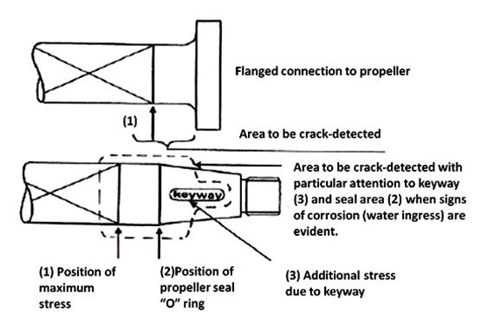
c) State with reasons what parts of propeller shafts should receive particularly close inspection upon withdrawal of such shafts for survey.
Crack detection may be by dye penetrant method or magnetic particle method. Magnetic particle inspection is preferred because it is more sensitive when properly carried out.
In both cases the area to be checked must be thoroughly cleaned. Where possible a qualified technician is preferred working to recognized standards.

Slide 5
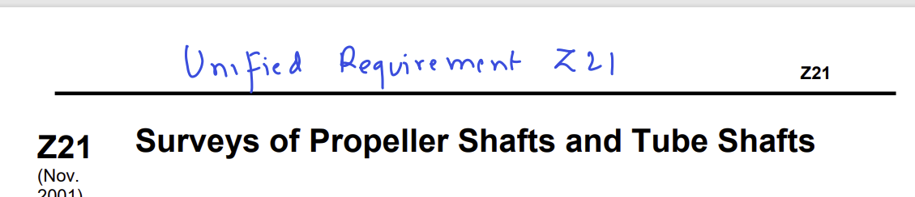
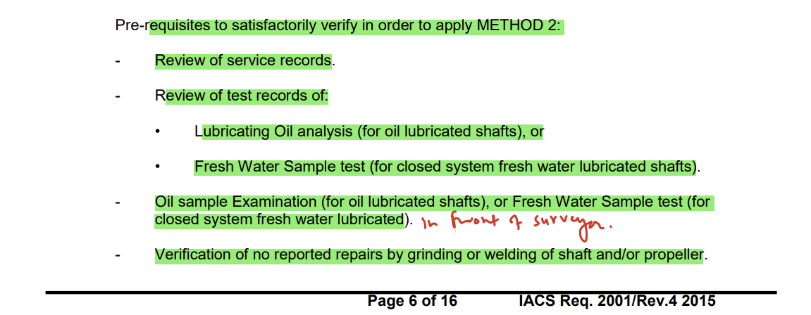
State why some propeller shafts require less frequent inspection than others
If following pre- requisites followed

